Slide 1
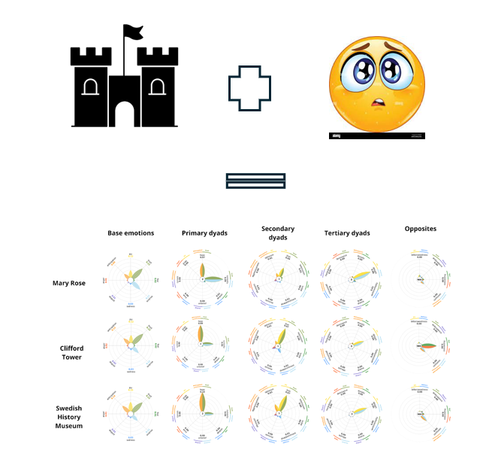
More than feeling? – Can digital humanities rewrite concepts from non-digital heritage studies?
TW//CW : suicide, war, religious violence, images of human remains
Dr Andrea Kocsis
Chancellor’s Fellow in Humanities Informatics
University of Edinburgh
National Librarian's Research Fellow in Digital Scholarship 2024-25
National Library of Scotland

Slide 2
What
What not
Not Linguistics
Not Computational Linguistics
Not Computer Science
Not Psychology
Heritage Studies
Computational Humanities
Acknowledging the disciplinary boundaries within interdisciplinarity
Need for collaboration and co-development

Slide 3
Positioning
Computational Humanities
Institutional and disciplinary boundaries as barriers to collaboration and quality (Erp et al)
Developing methods and their hermeneutics together (Ringler)
Are we controlling quantitative with qualitative or the other way around? Shall we have trust in the quantitative? (Algee – Hewitt)
Code quality in DH (Damerow)
Tilton, L., Mimno, D., & Johnson, J. M. (2024). Computational humanities. University of Minnesota Press.

Slide 4
Plan
The reason: What and why?
The theory: “Heritage that hurts” and its problems
Close reading: Tracing affect in heritage reviews
Distant reading: Emotion detection – how?
The problem: Why didn’t it work?
Discussion: What do you think?
TW//CW : suicide, war, religious violence, images of human remains

Slide 5
Case study
Kocsis, A. Using Computational Methods to Evaluate Affective Relevance at Historically Distant Heritage: Towards Computational ways of understanding what is ‘hot’ and what is not . In: International Handbook of Heritage and Affect. Angela Person and Jacque Micieli-Voutsinas, (Eds). Routledge. Expected: Autumn 2025.
More info about the volume: https://shareok.org/bitstream/handle/11244/340078/2023_Person_InternationalConferenceHeritageAffect.pdf?sequence=1&isAllowed=y

Slide 6
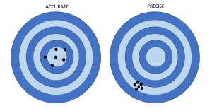
Why?
Can digital methods help us to do more reliable and valid humanities research?
Would grounding research in more data lead to more validity?
Would using semi-automated methods lead to more reliable results?
Accuracy (validity)
Precision (reliability)

Slide 7
The theory

Slide 8
“Heritage that hurts” “hot interpretation” – David Uzzel
Uzzell, D. L. (1989) „The Hot Interpretation of War and Conflict‟ in D.L. Uzzell (ed.) Heritage Interpretation: Volume I: The Natural and Built Environment, London: Belhaven Press.
Hot interpretation – Hot cognition: He suggests that there is a direct emotional way in which we can interpret experiences before or without thinking them over.
This emotional engagement can be fired:
if the experience resonates with our personal past,
nationalist feelings and community values,
ideological beliefs and convictions
the event is close in time and space
He encourages museums to curate spaces for hot interpretation →didactic purposes (←→Ashworth, Smith, etc.)
Coming from environmental psychology with an agenda against climate sceptics

Slide 9
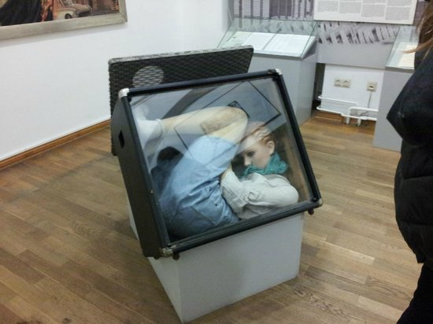
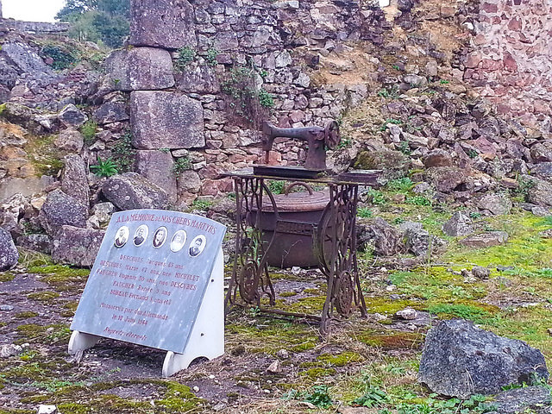
Time and hot interpretation
Uzzell “observed” heritage sites related to WW2 (Oradour-sur-Glane), WW1 (IWM), District Six Museum, Checkpoint Charlie Museum, and the Clifford Tower in York, and found that:
'as time separates us from past events our emotional engagement is reduced’.
→the likelihood of emotional reactions in response to a heritage site depends on the time passed between the original traumatic event and the visit.

Slide 10
My hypothesis
Uzzel’s argument on why the medieval massacre at the Clifford Tower in York does not allow hot cognition might not be correct (correlation =/= causation)
Curation and storytelling have the major impact on how “affective” heritage sites are, which is more important than the distance in time or space.
Note: Discussing the possibility and not the ethics of it

Slide 11
How to do this?
We need large scale data to avoid being anecdotical
Interviews? –> E.g. Laurajane Smith
Effective, but time and resource consuming
Interrogate already existing data:
Webscraping

Slide 12
Data and Methodology
1. Collected Reviews from TripAdvisor– ~5000 reviews
2. Analysed the exhibition and the curation techniques (Rose 2014)
3. Analysed the reviews:
Distant reading:
Topic Modelling
Emotion detection
Close reading
4. Overlapped the results
Machine Learning classification
(proposed)
Case studies:
Clifford Tower in York (n=2090)
Mary Rose Museum in Southampton (n=3000)
Medieval Massacre exhibition of the Swedish Historical Museum in Stockholm (n=740)
Next slide TW//CW : suicide, familicide, religious violence, war

Slide 13
The sites and the connected tragedies
Site | Event | Date | Casualties | Reference points to anchor emotions
Clifford Tower, York | Pogrom, mass suicide, and massacre of Jews | 1190 | ~150 (20-40 families) | Location, primary sources, the legacy of pogroms in historical consciousness
Mary Rose Museum, Southampton | Sinking of the ship | 1545 | ~500 crew members | Location, material culture, human remains, primary sources
Medieval Massacre exhibition of the Swedish Historical Museum, Stockholm | Battle of Gotland (Visby) | 1361 | ~1800 farmers | Material culture, human remains, visuals of the excavation, primary sources

Slide 14
The exhibitions

Slide 15
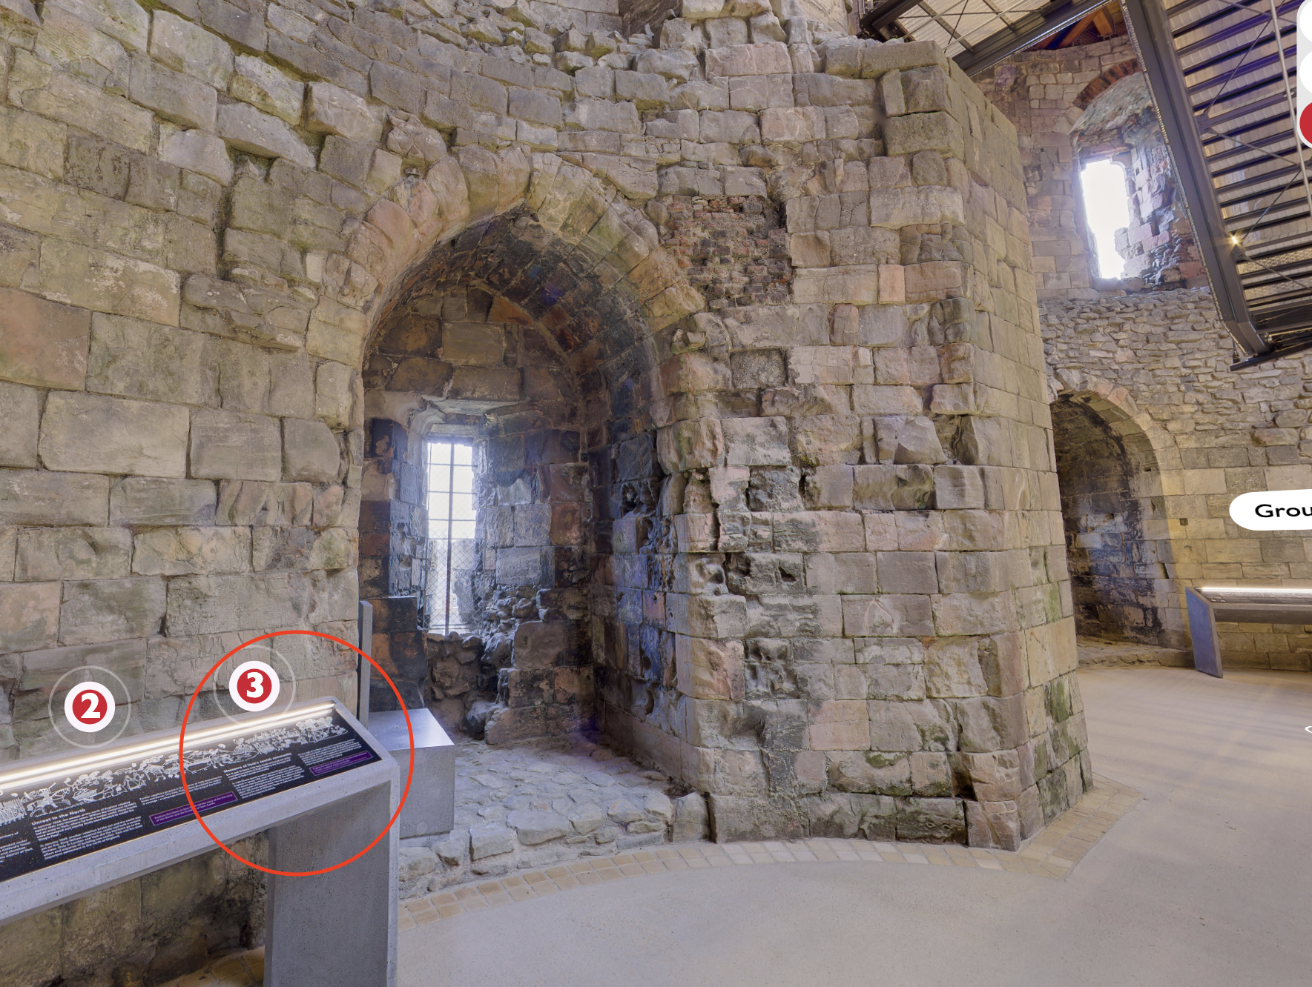
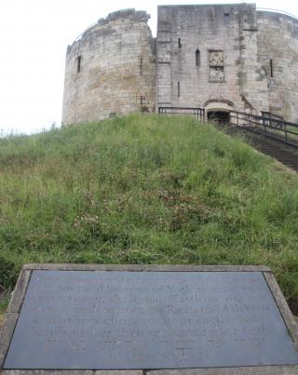
Curatorial techniques: Clifford Tower
Next two slides TW//CW : skeletal human and animal remains
English Heritage
Building-architecture focused, no storytelling
No information or installation on the massacre, apart from a recently added plaque inside
Recently reinstalled, but the the majority of the reviews are form pre-renovation

Slide 16
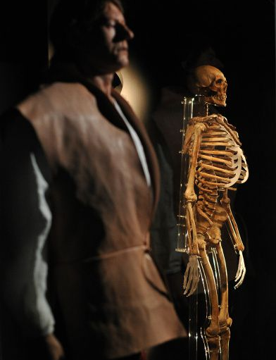
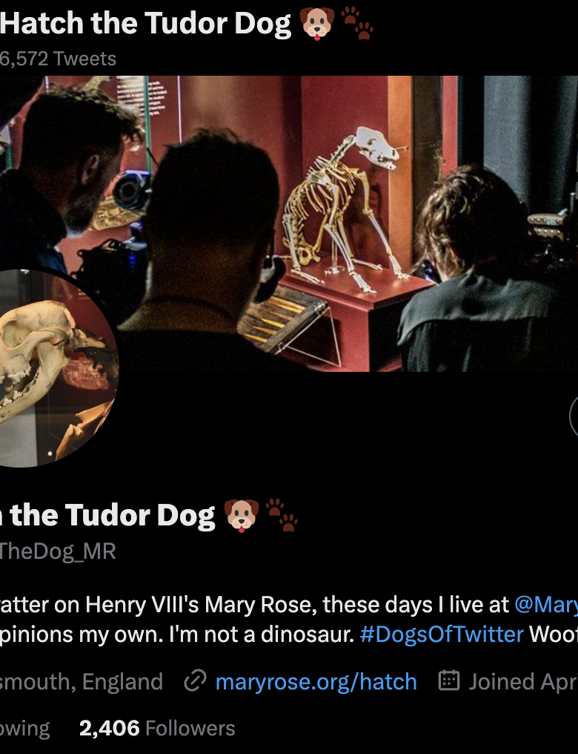
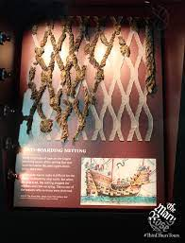
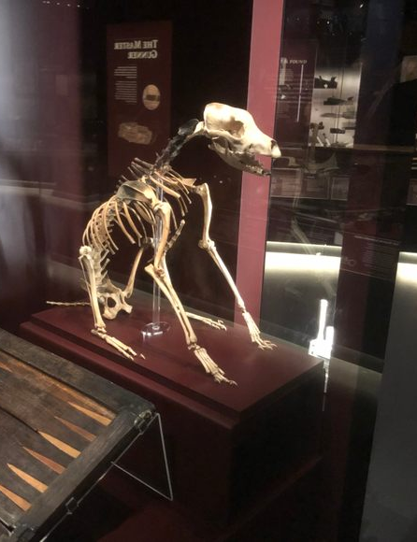
Curatorial techniques: Mary Rose
It has unique material culture but uses it for prompting a story
Intimate access, groups of 10s
Each group has a guide
After entry: projected installations of sinking with the ship -> immersive embodiment
Storytelling focused on the lost lives (not only on the death) from the beginning of the exhibition
“dead dog narrative”
The “heritage gaze” (McDonald 2009) for the rich material culture comes only after setting the agenda

Slide 17
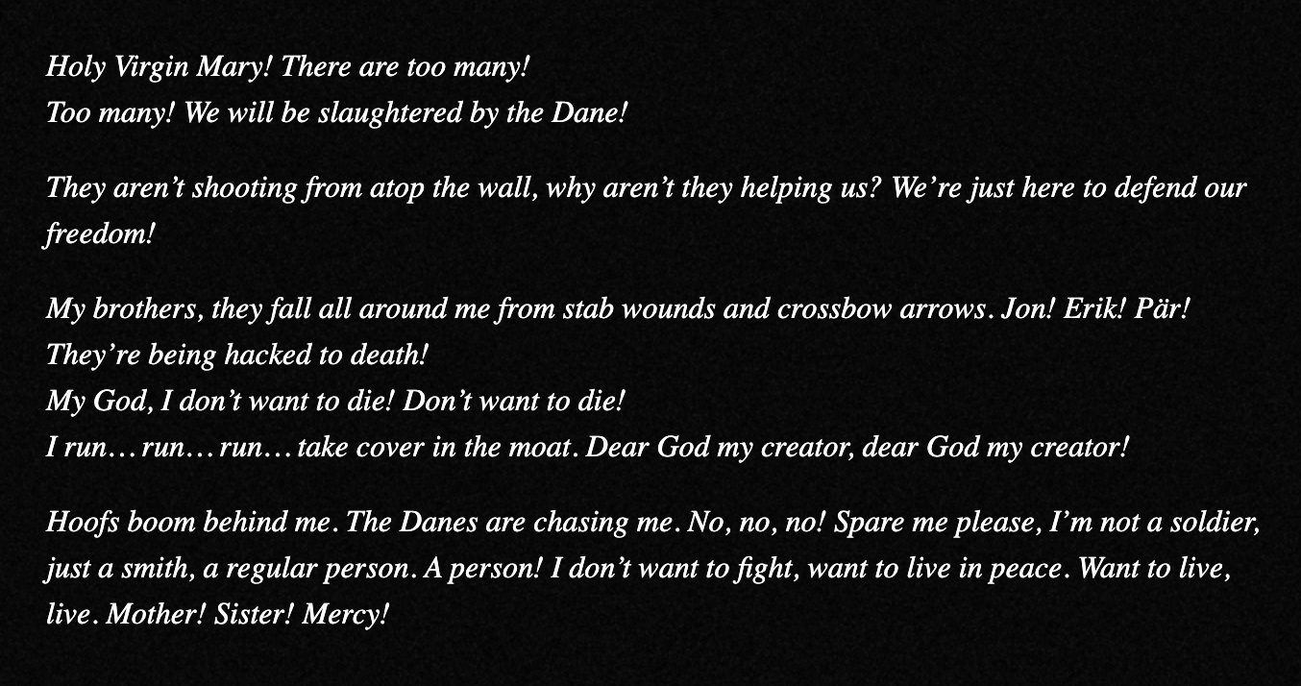
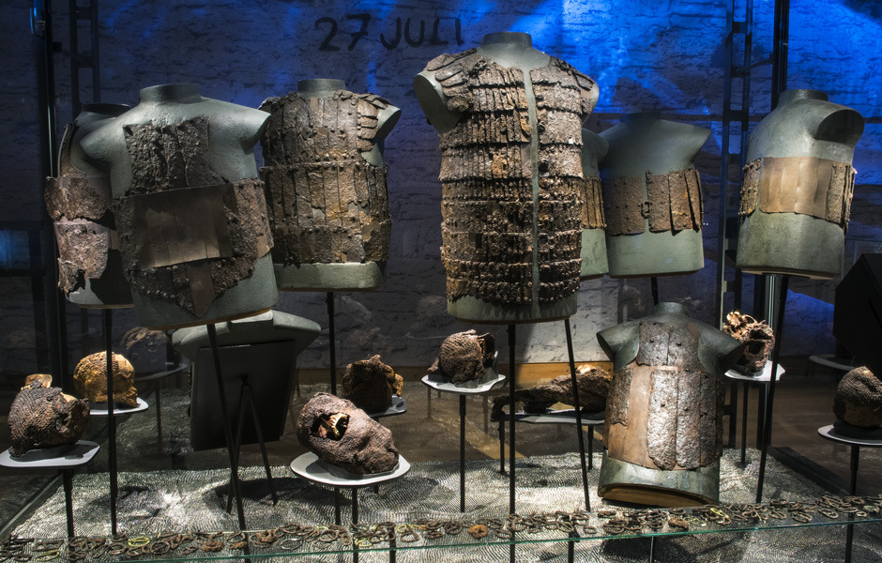
Curatorial techniques: Medieval Massacre room, Stockholm
Uses material culture, human remains, excavation photos, audio-visuals, and storytelling to demonstrate
-> “that acts of violence and war are recurrent, destructive phenomena through the ages”
Intentionally aiming for “hot interpretation”
https://www.youtube.com/watch?v=3QKOcrMU0xI&rel=0

Slide 18
Hot interpretation in the curatorial techniques
Hot Ice cold
Medieval Massacre | Mary Rose | Clifford Tower

Slide 19
The results of the close reading

Slide 20
Cat 1: A bloody history with a great view.” (no. 176). | Cat 2: Expecting more interpretation of the event. These visitors arrive with previous knowledge and expectations of hot interpretation, which the exhibition fails to fulfil. | Cat 3: Visitors whose commitment to commemoration was so strong that they could project it to the site, which in return could affect them: | Cat 4: Chasing thrill instead of compassion | Cat 5: Affected : 7 out of the 2090
These remarks address the event with rich, sometimes gory terms (“bloody”, “burned themselves”, etc.) but insert them in an operative context | “No info on the massacre of the Jews (...) which was a pity.” (no.13), | “We found it quite moving to visit as we knew about the massacre of the York Jews before we went” (no.1801). : | “Stories for those fascinated by horror of the persecution of the city's Jewish residents, leading to their suicide, to the time when the tower was almost accidentally exploded“ (no. 508); | These remarks can refer to a physical embodiment, such as “this thought sent shivers down my spine, which I guess must resemble what one would experience when visiting other horrifying sites such as Auschwitz.” (no. 882).
 | “a few plaques explaining the bland side of its history, there’s no mention of the massacre of Jews” ( no. 18). | “We came and said prayers for the souls of the dead ” (no. 682); | “This tower has many cruel events in its life, starting with the masacre of 1100 jews in its arly years, It is told that at some nights the stones turn red, as a result of all the blood shed.” (no. 1302). | They can express triggered empathy, like “The ordeal for those poor jewish families must of been horrendous” (no. 1374)
 | “not much made of the Jewish martyrs” (no. 1246) | “(...)it is also a sacred site.” (no. 784); |  | Finally, they can display the combination of physical, emotional, and intellectual reflection: “I am not of the Jewish faith but it still haunts me to think of the pogram albeit hundreds of years ago and by "modern" standards some would say small scale". (no. 1100)
 | “The Heritage Trust [sic!] fails to present this story in any useful context.” (no. 1960). | “we even saw from a distance a jewish remembrance ceremony being privately performed by the tower at the entrance. “ (no. 1251).

Slide 21
Embodiment via their senses: | The sight of the ship was the culmination of the visual impulse | They received the intended message of the storytelling | Referring to the crew being “brought to life” is a recurring pattern | Contemplating the life of the crew went hand in hand with acknowledging their death
“You could experience the smells, and sounds on board. It was an eerie experience” (no. 105); | “the first glimpse of the ship brought goose bumps. The whole museum is very cleverly done, creating a real sense of awe” (no. 236); | “It's hard to imagine that the huge hull of the Mary Rose does not dominate this exhibition, but there is so much more to see that it is set in context. (no. 92). | “very atmospheric bearing in mind over 500 people lost their lives on her. She is brought back to life with very clever holographic images and sounds which show people on board her carrying out their work” (no. 101). | “You end up feeling for the lost sailors and wandering in awe at both the way they lived and died” (no. 612);
“atmospheric noise if creaking wood and sea and the projected pictures of what life on board would have been like were thrilling” (no. 316). | “For me the sight was overwhelming” (no. 5); | “we also loved the way that displays were shown with reference to real people who had worked on board. It made it so easy to relate to” (no. 15). | Craftsmanship of the crew and their material culture: “very moving as you get to see a range of personal artefacts from the ship’s crew.” (no. 56). | “it is also a memorial to the crew, of whom over 400 lost their lives.” (no. 151);
“this place gives me chills!!” (no. 119). | “I didn’t expect to have such a strong emotional reaction to the Mary Rose. She took my words away!” (no. 6). | “They tell the stories of the people who were the crew in ways that help you understand their lives.” (no. 21). |  | “like an atmospheric ghost” (no. 534).
 |  |  |  | “a visit is stunningly moving” (no. 467),
 |  |  |  | “very moving tribute to both a real human tragedy” (no. 97
 |  |  |  | “Sadly they have a skeleton of a dog that was found inside the doorway of a cabin he had awaited the return of his master.” (no. 330).
 |  |  |  | “mind blowing experience, emotional when you think of the whole story, absolutely absorbing and thought provoking” (no. 190).

Slide 22
The verbs and adjectives the visitors use are unusually dark, suggesting that the exhibition achieved a magnetically gothic, even brutal atmosphere: | Incorporated gore: | The visitors also reacted to the sensory experiences. Between excitement and hot cognition: | Adapted to the message and language | Ethical problem with the exhibition as showing signs of affect or engaging in the morbid thrill:
“a quite disturbing medieval massacre exhibit” (no. 631) | “There is nothing like skulls with holes in them to remind you how these people died.” (no. 626). | “exciting to see the projected film of an marching army in the exhibition of when the Danes attacked Gotland and hear the sounds with it” (no.12). | “The battle of Gotland for example is a terrible event, reenacted with noises, artifacts, informations which could transform military personnel into anti military advocates” (no. 582). | “The Midieval Massacre exhibit is also exceptional. It can be a little overwhelming at times” (no. 150).
“we encountered the well-presented albeit grim relics from the Battle of Gotland 1361. The exhibit features skeletal remains and weapons recovered from a brutal battle between Gotland farmers and professional Danish soldiers. Medieval life must have been nasty, short and brutish.” (no. 360); | “Particularly interesting, though gruesome, was the display featuring dead corpses and skeletons of those soldiers that had participated in the Battle of Visby in 1361, with their bodies showing the effects of blows and hits.” (no. 70); | “To set a sense of foreboding a tone sounds in the room followed by fleeting images of soldiers on projected on the walls. The sound of arrows fly by and then cheering followed by cries and moans. It is the most haunting depicting of the horrors of battle I have seen in a museum.” (no. 543). | “the Danish assult of Visby in 1361” (no.105), -> the use of “assault” instead of “attack” suggests an unconscious reaction to the storytelling. | “Children will love ( or be scared by) the mediaeval massacre display where the victims' skeletons were found still dressed in their chain mail and armour - a unique find.” (no. 155)
“you are drawn into it. One hall deals with the mass grave of farmers on Gotland slaughtered during an attack by an invading Danish army. You learn about the event, the artifacts, the archeology and you are drawn in to the event.”(no. 626). | “The room presented (...) shattered, hacked and crush skulls, some forever wedded to remnants of the chain mail they had worn to battle”. (no. 543). |  |  | “This lack of a meaningful display, struck me as being disrespectful of human lives that have passed” (no. 133).
The reviews include a list of gory terms (like haunting, horrors, bodies tossed, shattered, sense of foreboding, disturbing, scared, nasty, brutish, tragically, gruesome, human mortality, etc.), which are unusual in the overall operational language of TripAdvisor, and suggest the presence of hot cognition of the displayed trauma.

Slide 23
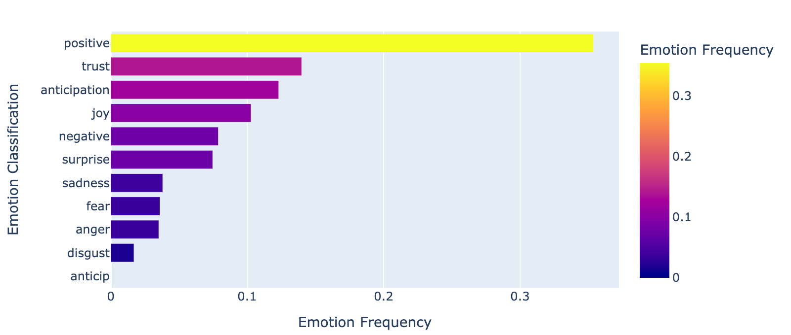
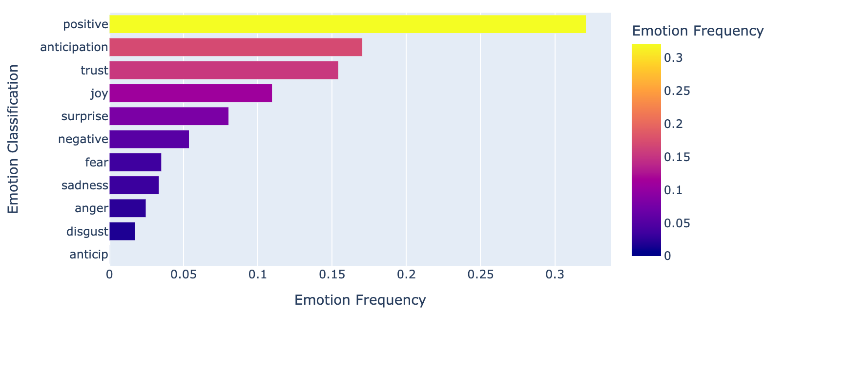
The problem
Curatorial approach
Audience reaction based on close reading
Medieval Massacre: The audience reacted to the message and incorporated the approach | Mary Rose: The approach of balancing the awe of material culture with sentiments towards the crew via storytelling resulted in hot cognition | Clifford Tower: Despite the efforts of not focusing on the tragedy, those sensitive to it were affected
Distant reading

Slide 24
The Problem
The close reading and the distant reading contradicts
The close reading differentiated between very different emotions composites based on the three different curatorial techniques applied at the exhibitions
←→The distant reading washed them together
→Emotion detection in this case was not valid
←→the method is used widely without control: applications, detections, predictions, analysis, tweet profiling, etc.

Slide 25
The emotion detection

Slide 26
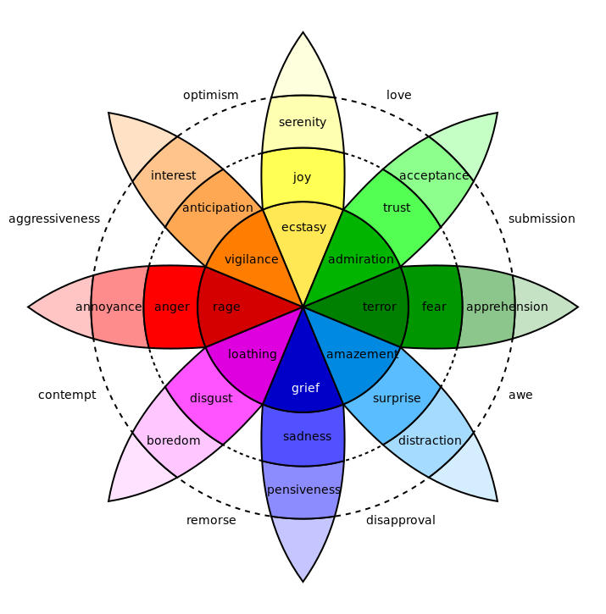
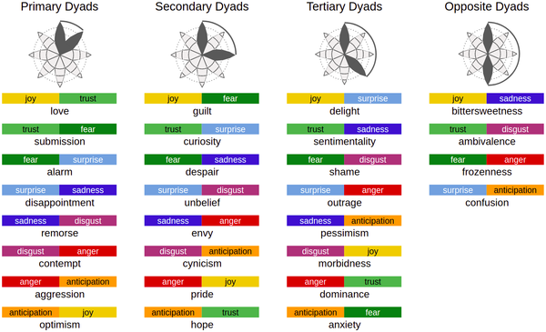
How Emotion detection works
Lexicon – based approach
The lexicon is based on crowdsourcing and WordNet synonyms
Which is based on the Plutchik wheel of emotions, a categorical emotion theory

Slide 27
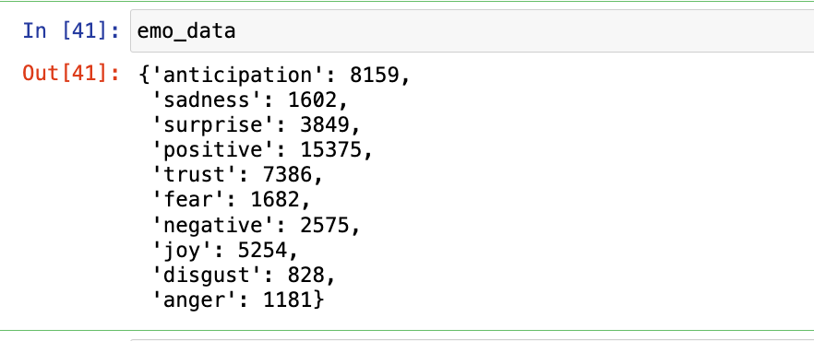
It works with a few lines of code, example use:
NRCLex package – attaches the scores to the tokens based on the lexicon labels ( (Bailey 2019)
Can be displayed with Pandas Dataframe
Frequency can be plotted with Plotly
Works only with base emotions → very limiting use

Slide 28
Mitigating: Adjusting the dictionary
Extracted the relevant portion of the lexicon -> relabelled them to reflect:
1) consistent base emotions based on the dyads
E.g.: ache: sadness, but if we add fear, on the secondary level, we will get despair, which describes ache better than sadness.
adore: joy+trust is love on the secondary, which is closest to adore than joy
2) the intensity e.g. add base motion disgust for boredom
3) the heritage context and review specific: e.g. : authenticity, ancient, etc. - mostly added to the curiosity dyad
Helmet – in the Stockholm context, that is an affective word

Slide 29
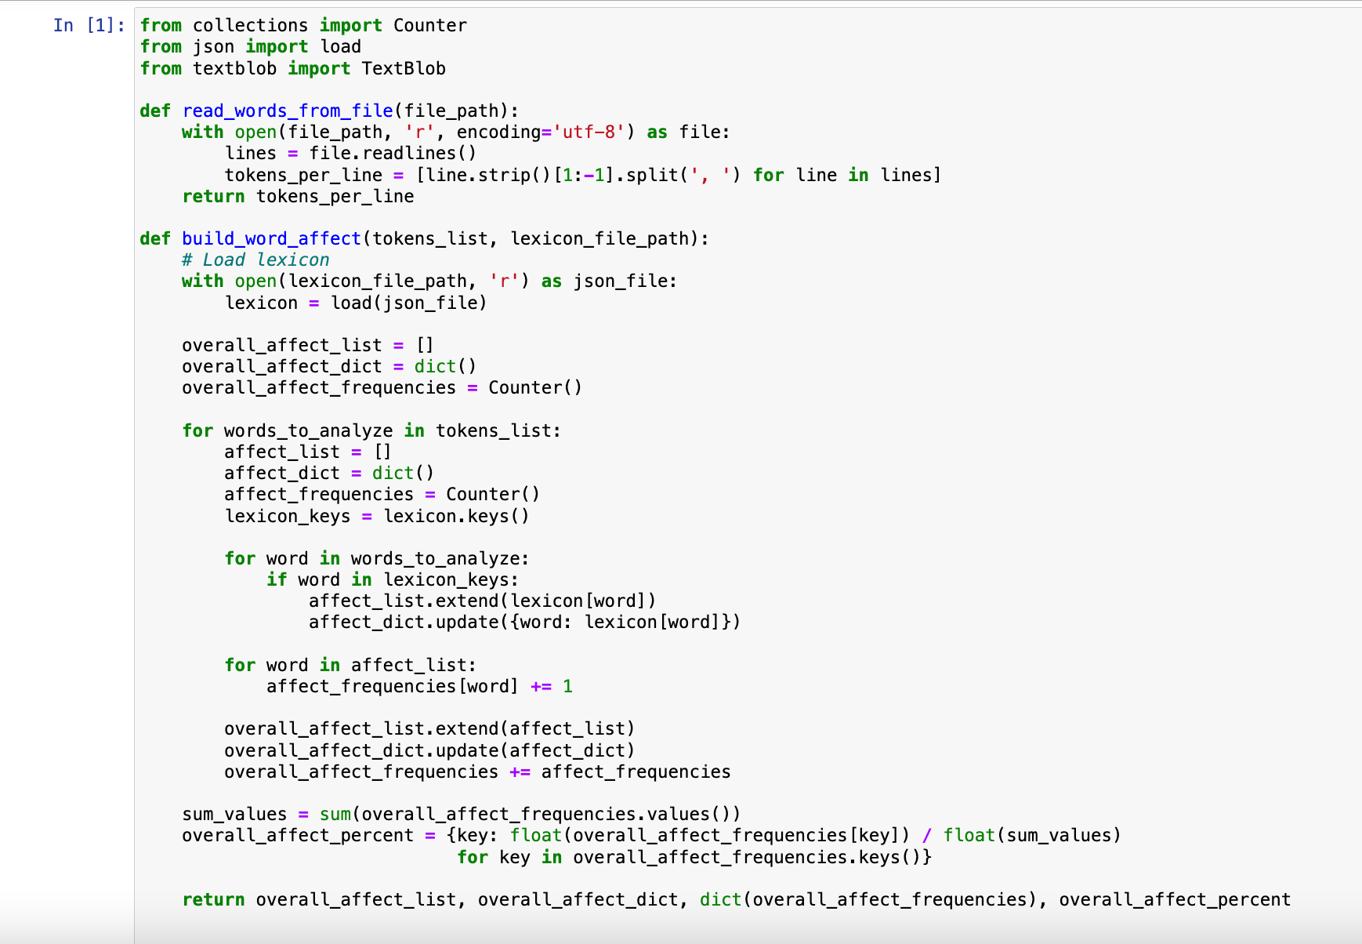
Adjusting the code - Workflow
Getting original emotion frequencies with NRC lex
Exporting the emotion lexicon in JSON
Manual re-labelling the lexicon in Openrefine, exporting as CSV
Importing CSV into Pandas dataframe
Generating dyad labels (primary, secondary, tertiary, opposites)
Refactoring NRCLex code to accommodate these dyads
Getting new emotion frequencies, including the dyads based on the new lexicon
Generating petal graphs with PyPlutchik for each dyad (Semarro et al. 2021)

Slide 30
Still: categorical understanding washes the differences out

Slide 31
Why is it?
Tautology: the method is reliable, but not valid --> it finds what it searches for, but that does not represent the reality
Crowdsourced emotion labels might not be the best option when exploring a niche subject as the lack of expertise and specialisation tends to increase the uncertainty of the annotations (see Kocsis - Ogden 2023). --> volunteers did not follow the theory closely, contradictions
Similarly, the categories of emotions in the Plutchik wheel do not translate to the dimensions of emotions of the heritage experience, which indicates the need for a specialised taxonomy for heritage studies (e.g. black =/= sadness, and the dyads don’t correspond to the real emotions felt at sites)
As heritage affect seems to be a fluid composite of various emotions, sensations, and reflections, rigidly structured approaches might not bring valid results even with revised lexicons

Slide 32
Suggestions
Reworking a full heritage-specific lexicon
Trying it on interview data (aiming only at emotions)
ML classification → training to find affect, but let it choose the components
Try unsupervised methods, where the machine has to figure out what affect is in heritage context (promising)
Quantifying the error: confusion matrix

Slide 33
Takeaways
Revising heritage theory: you can feel for the medieval tragedies if exhibited well
Extant data, such as Trip Advisor, can replace interview data, so thumbs up for web scraping
For affect detection, go with close reading for now
Be careful with off-the-shelf methods, and check if the question, the method, the data, and the result match to assure both reliability and validity
Qualitative – quantitative reliance?
Developing tools along their hermeneutics
Need of cross-disciplinary collaboration

Slide 34
Thank you!
Read it: Kocsis, A. Using Computational Methods to Evaluate Affective Relevance at Historically Distant Heritage: Towards Computational ways of understanding what is ‘hot’ and what is not . In: International Handbook of Heritage and Affect. Angela Person and Jacque Micieli-Voutsinas, (Eds). Routledge. Expected: Autumn 2025.
akocsis@ed.ac.uk
@aurigandrea
@andreakocsis.bsky.social

